Slide 1
Design and Pitch
By: Ana, Brook, Kelly, Zamzam

Slide 2
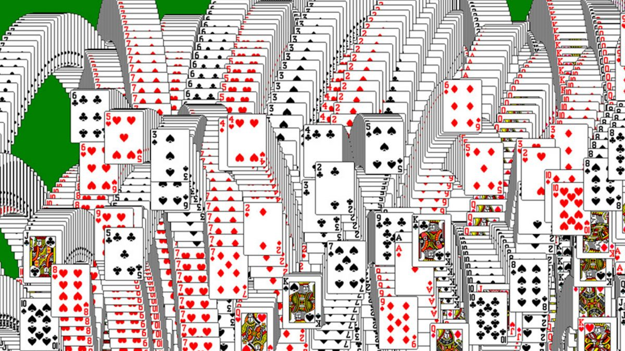
Introduction
We are working on Solitaire which is is a card game that is only played with the objective of using up all ones cards to form particular arrangements and sequences.
Today we will show you guys our design—we will show all the components we have and explain how it will work.

Slide 3
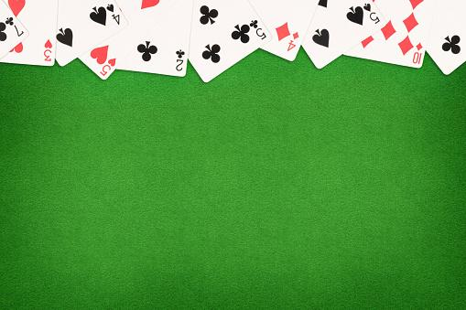
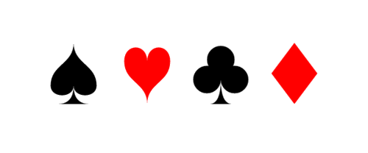
SOLITAIRE
1
New Game
Continue Game
Game Rules
High Scores
2
3
4
5

Slide 4
Component Description
COMPONENT ID | NAME | DESCRIPTION
1 | Title | Shows the name of the game.
2 | New Game | Enables user to start new game.
3 | Continue Game | Enables user to continue existing game.
4 | Game Rules | Instructions and game rules of standard Solitaire.
5 | High Scores | Enables user to see previous high scores.

Slide 5
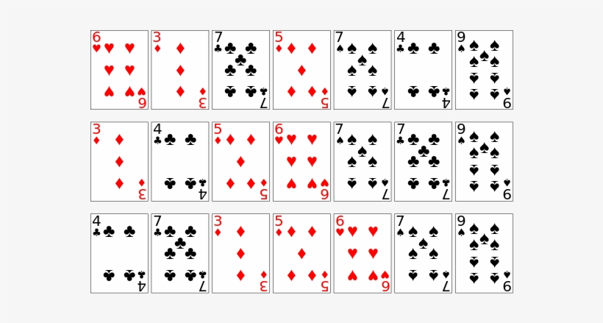
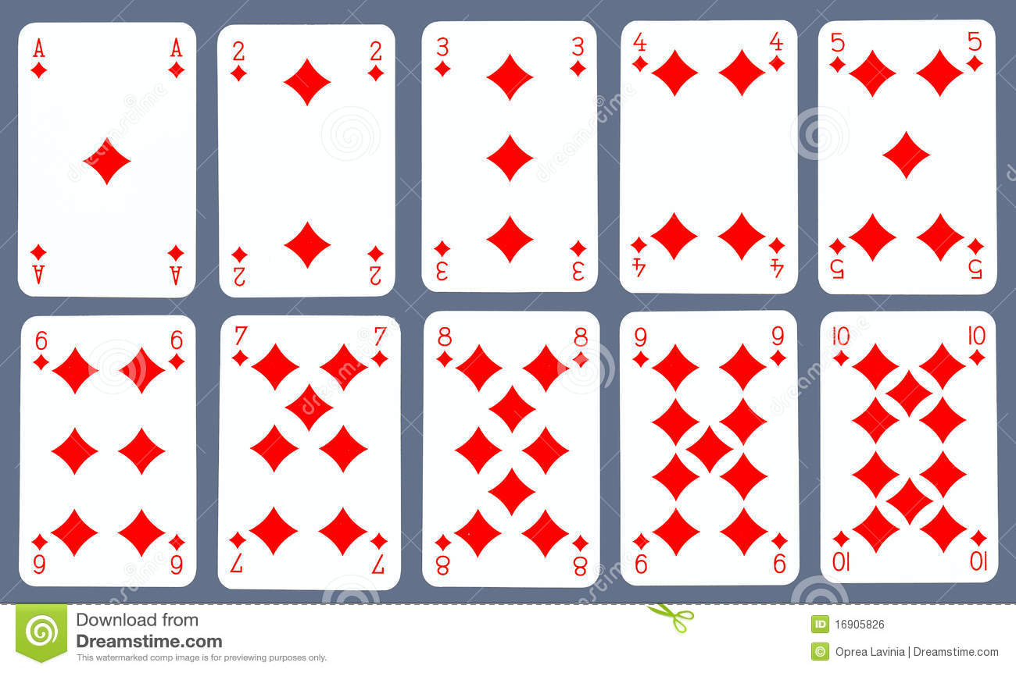
11
6
9
10
8
7
Hint
New Game
Exit Game
Score:
Time:

Slide 6
Component Description
COMPONENT ID | NAME | DESCRIPTION
6 | Hint | Helps user to find useful moves.
7 | Time | Times how long it took user to finish game
8 | Score | Keeps track of game score.
9 | New Game (in game) | Resets cards to new game.
10 | Exit Game | Ends the program.
11 | Recycle Stock | Allows user to recycle cards to the stack.

Slide 7

Challenges
Scheduling Conflicts
A little behind on the programming aspect of the project
Agreeing on the common theme of the game design
Time management

Slide 8
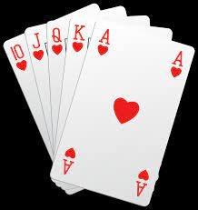
Plan for Remaining Work
Meet up and decide what would be the best way of dividing the stages of the project.
Discuss what parts of the project each member wishes to take upon.
Start collecting images and decorations that can be implemented on the design of the screen.

Slide 9
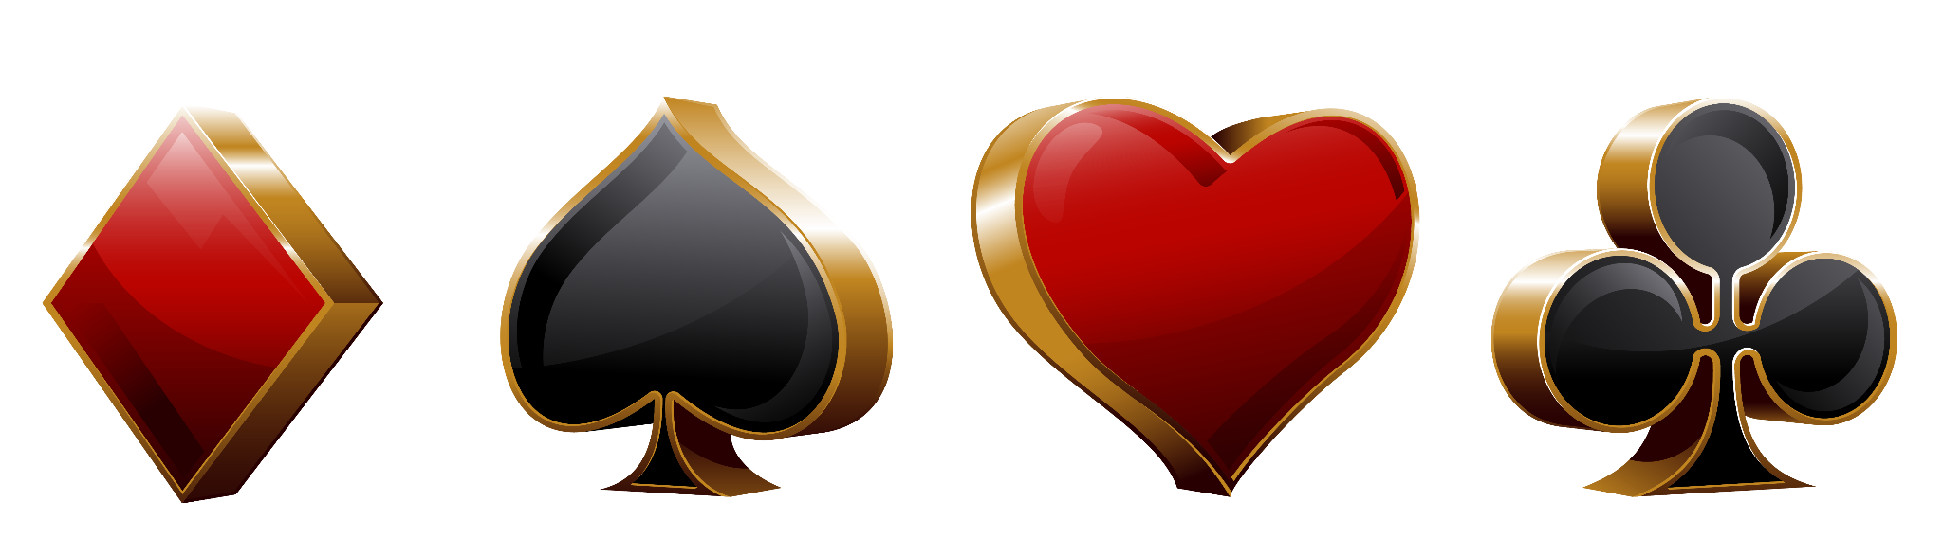
Conclusion
There is still a long way to go but now we have a good idea of what the final project should look like and have discussed what would be the aspects of the game we should put more effort on.

